Slide 1
What is a Pivot Table?
A Pivot Table is an Excel feature that summarizes large amounts of data into meaningful reports without changing the original data.
It helps to
Calculate totals
Compare categories
Count records
Find averages
Generate reports quickly
Example :
Instead of reading 10,000 sales records manually,Pivot Table can showTotal Sales by Department

Slide 2
Sample Dataset
Employee | Department | City | Month | Sales
Amit | Sales | Chennai | Jan | 45000
Priya | HR | Bangalore | Jan | 22000
Rahul | Sales | Hyderabad | Jan | 51000
Sneha | IT | Chennai | Jan | 62000
John | Finance | Delhi | Jan | 38000
David | Sales | Mumbai | Feb | 47000
Anita | HR | Delhi | Feb | 26000
Arun | IT | Chennai | Feb | 64000
Kiran | Finance | Hyderabad | Feb | 41000
Riya | Sales | Mumbai | Feb | 55000
Karthik | Sales | Chennai | Mar | 52000
Meena | Finance | Delhi | Mar | 43000

Slide 3
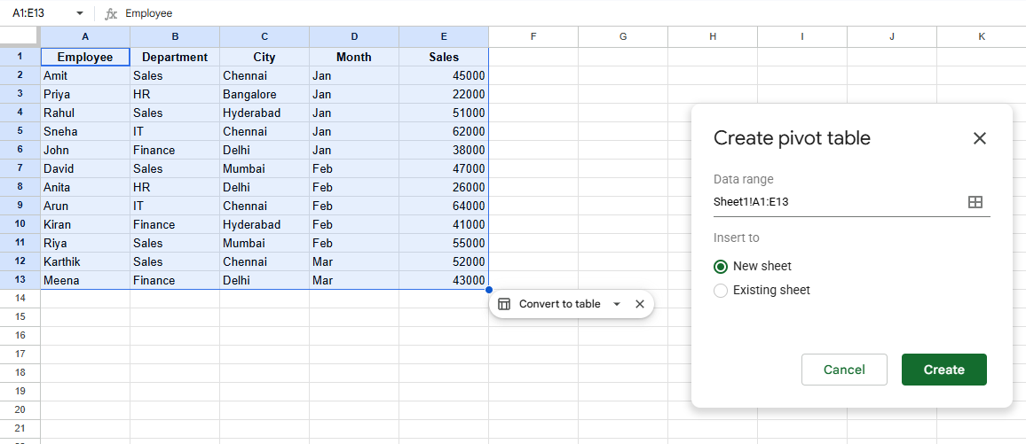
To Create pivot table select entire data sets and select pivot from insert
create a new sheet

Slide 4
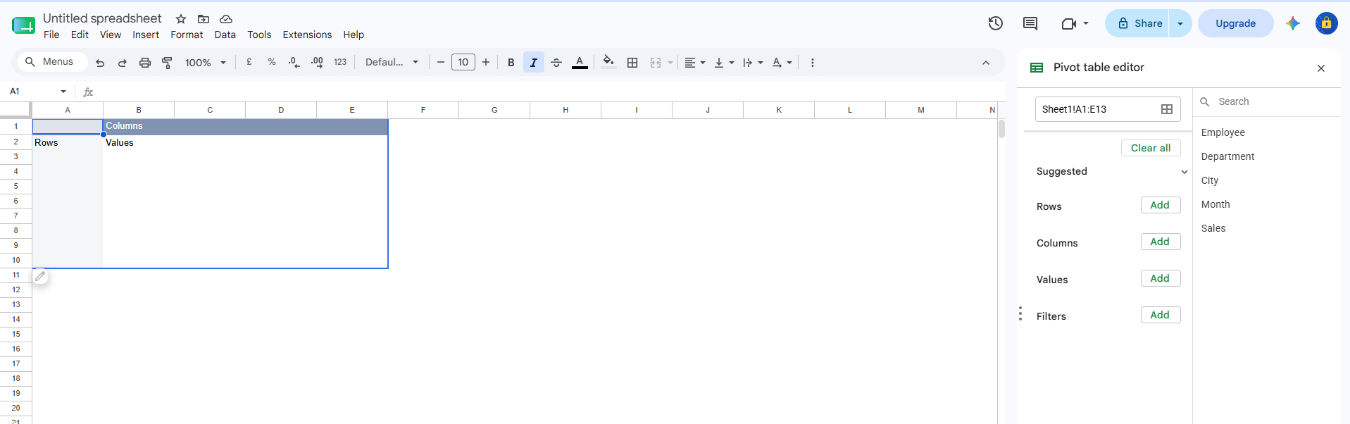
In this we’ll see empty pivot table and , pivot table editor
using that pivot table editor well edit add rows , columns , values , filters

Slide 5
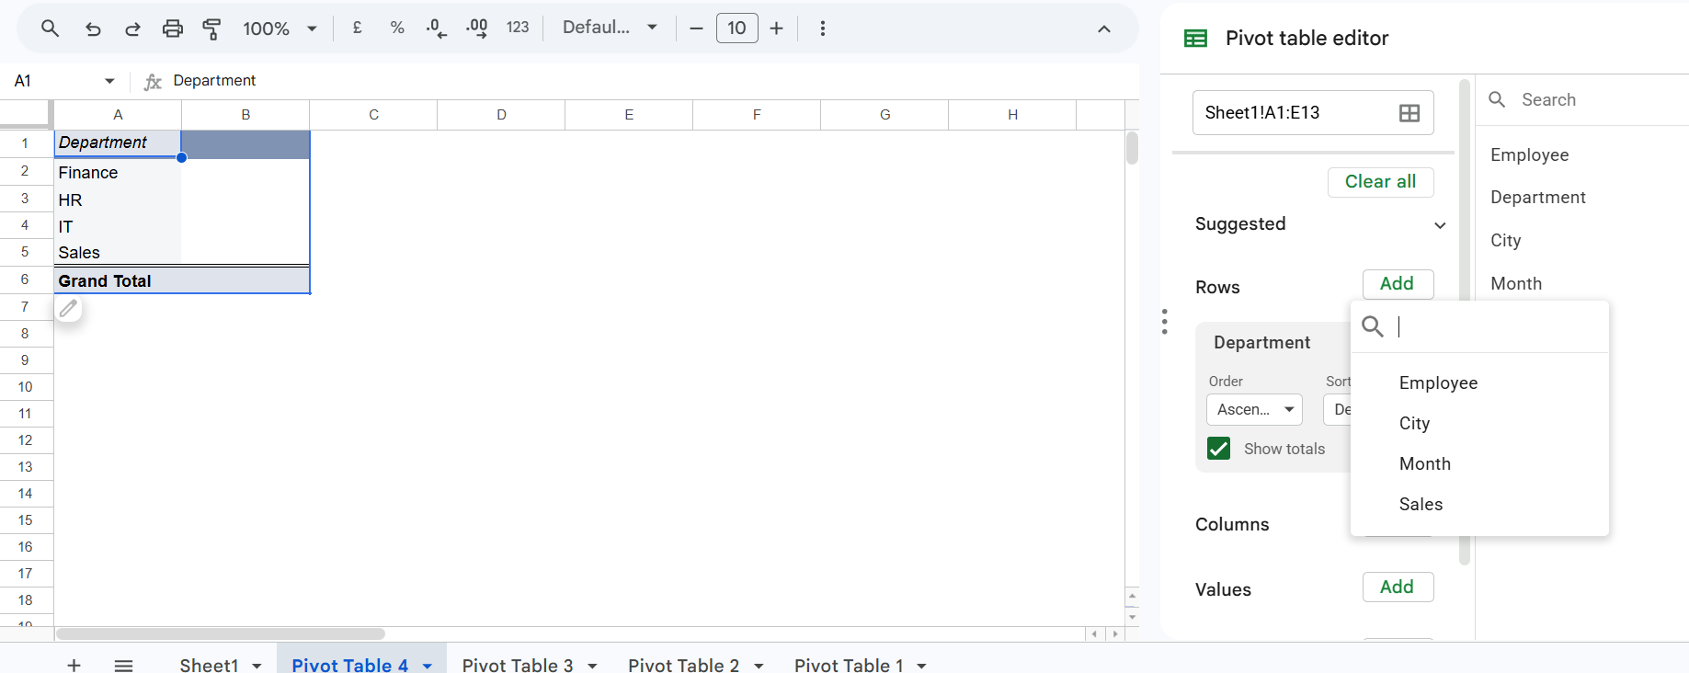
We can add each columns or rows by pivot table editor

Slide 6
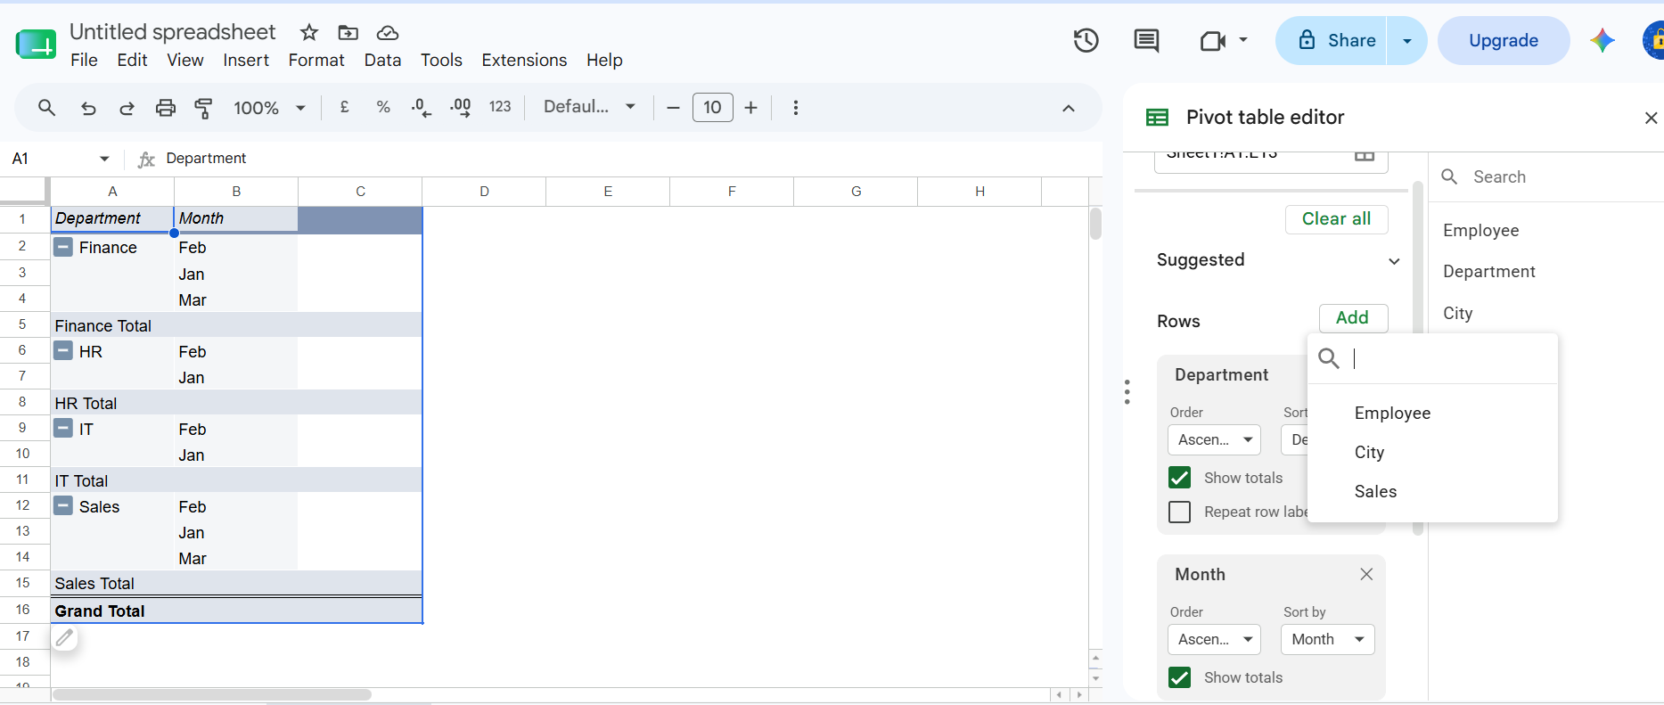
We can also edit and filter the order view

Slide 7
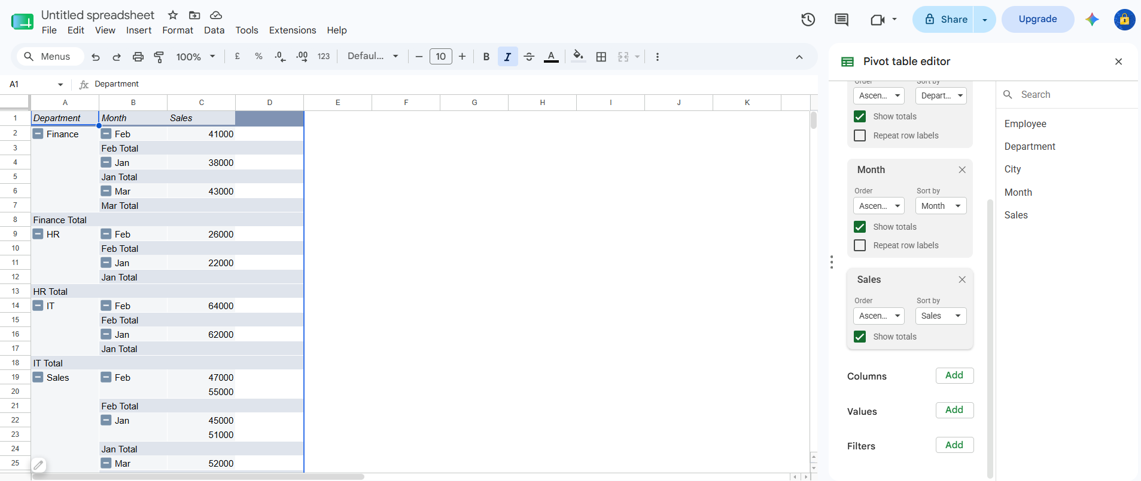

Slide 8
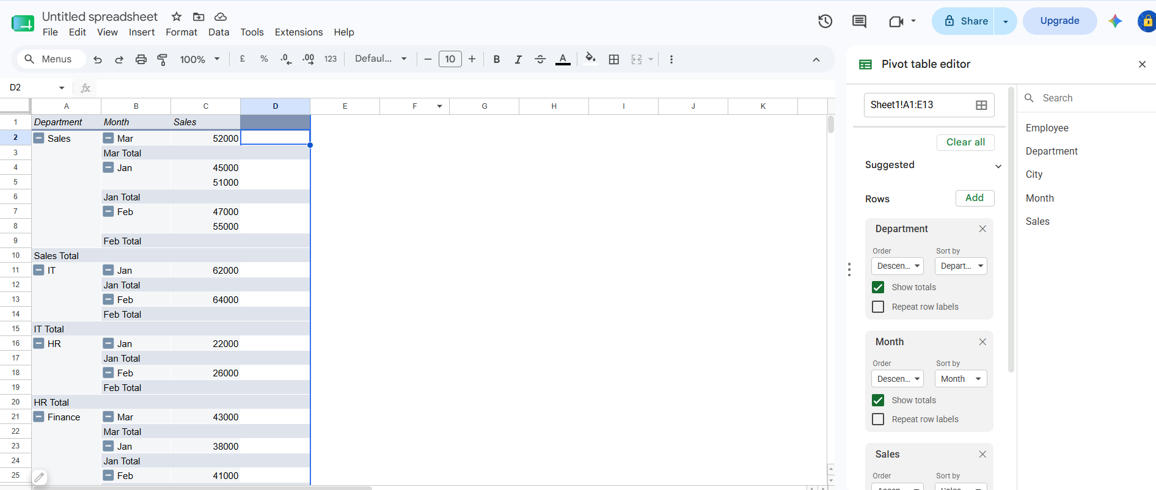
We can filter every rows by both accending and decending order

Slide 9
What is a Pivot Chart?
A Pivot Chart is a dynamic chart that is directly linked to a Pivot Table. It automatically updates whenever the Pivot Table changes.
Benefits
Visual representation of Pivot Table data
Updates automatically with Pivot Table changes
Easy to analyze trends and comparisons
Supports filtering and interactive analysis
Useful for dashboards and reports
Example:
A Pivot Table showing Sales by Department can be displayed as a Column Chart, making it easier to compare department performance.

Slide 10
Steps to Create a Pivot Chart
Select any cell inside the Pivot Table.
Go to the PivotTable Analyze tab.
Click PivotChart.
Choose a chart type.
Click OK.
Navigation :
PivotTable Analyze
↓
PivotChart
↓
Choose Chart Type
↓
OK

Slide 11
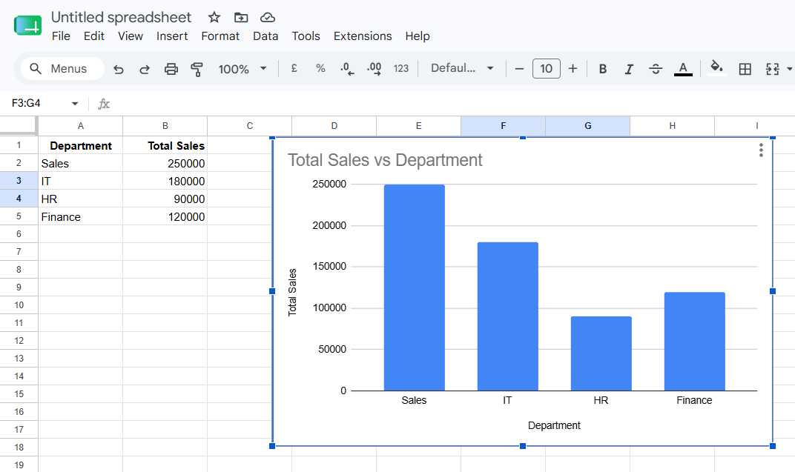
Example Dataset :
Department | Total Sales
Sales | 250000
IT | 180000
HR | 90000
Finance | 120000

Slide 12
Dynamic Relationship
A Pivot Chart is connected to its Pivot Table.
If you:
Change the Pivot Table fields
Apply filters
Refresh data
Group data
The Pivot Chart updates automatically.

Slide 13
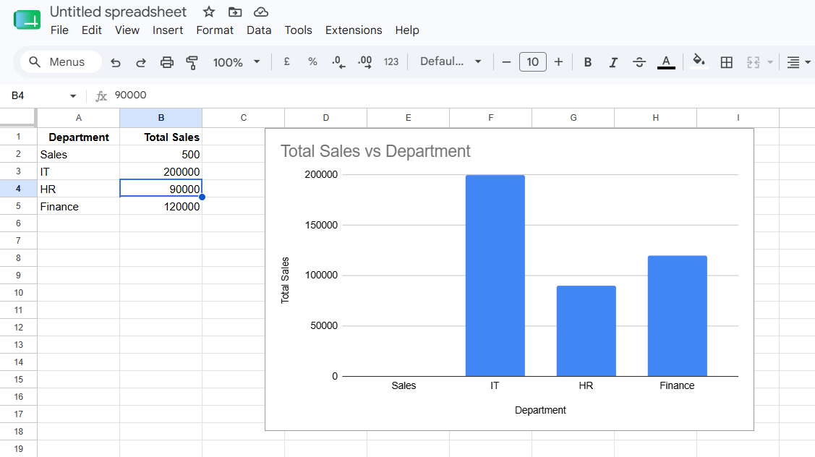
After filtering only Sales and IT, the chart displays only those departments.

Slide 14
Slicer
A Slicer is an interactive filtering tool used with Pivot Tables and Pivot Charts.
Instead of using drop-down filters, users simply click buttons to filter data.
Advantages
Easy to use
Interactive filtering
Professional dashboards
Multiple selections
Clear visual indication of active filters

Slide 15
Creating a Slicer
Steps
Select the Pivot Table.
Open PivotTable Analyze.
Click Insert Slicer.
Select the field.
Click OK.
Navigation :
PivotTable Analyze
↓
Insert Slicer
↓
Select Department
↓
OK

Slide 16
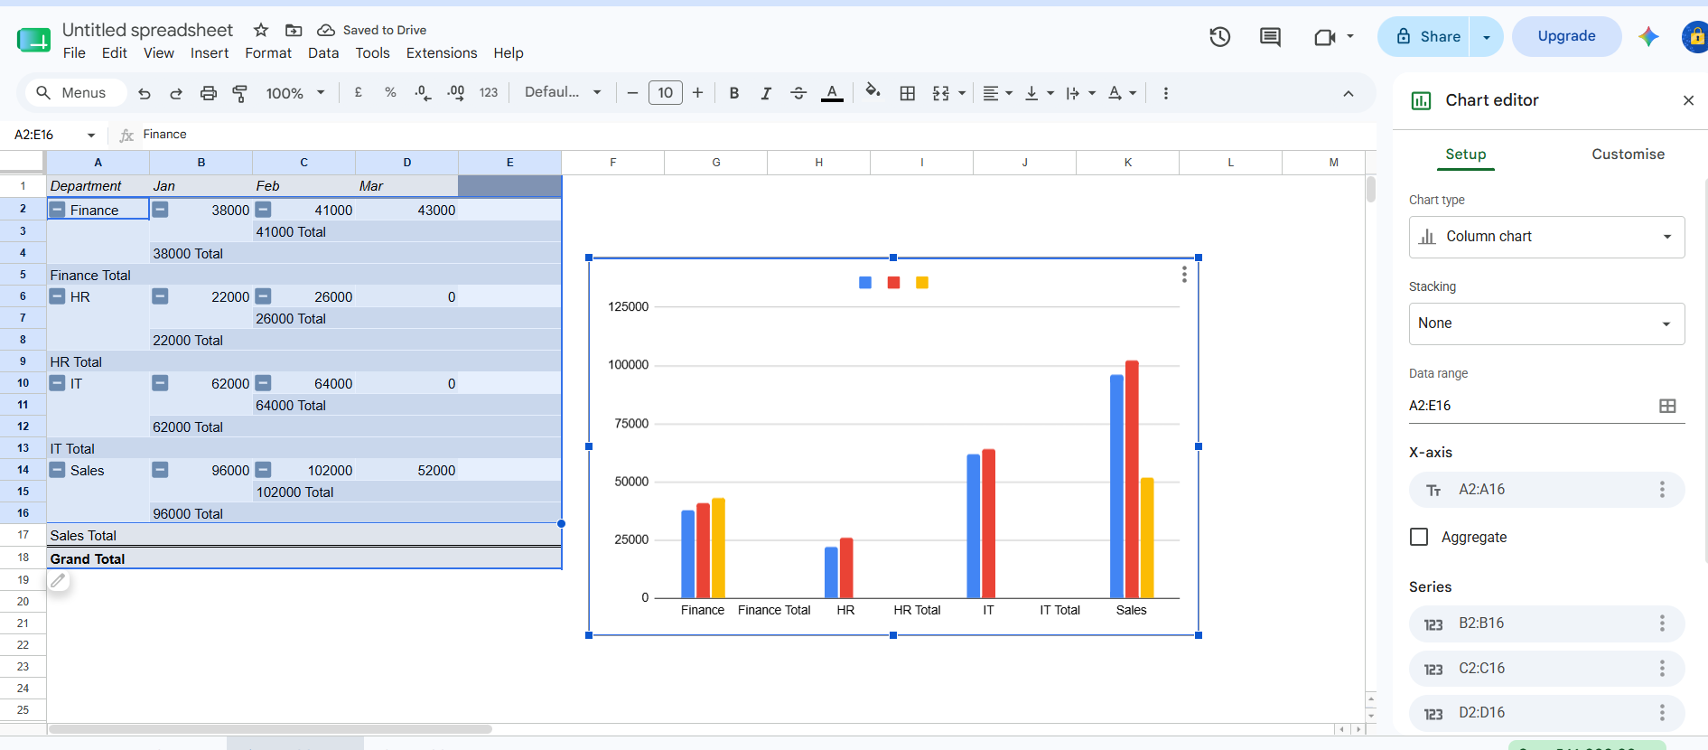
Click anywhere inside the Pivot Table.
Select the Pivot Table range to – Create Chart

Slide 17
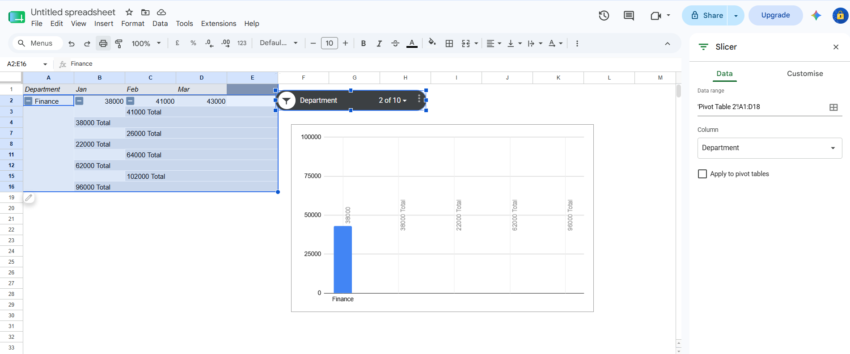
Data → Add a slicer

Slide 18
Timeline
A Timeline is a special filter used only for Date fields in a Pivot Table.
It allows users to filter data by:
Year
Quarter
Month
Day
Steps to create :
Select the Pivot Table.
Go to PivotTable Analyze.
Click Insert Timeline.
Select a Date field.
Click OK.
Navigation :
PivotTable Analyze
↓
Insert Timeline
↓
Select Order Date
↓
OK

Slide 19
Slicer vs Timeline :
Feature | Slicer | Timeline
Purpose | Filter any field | Filter date fields
Works With | Text, Number, Category | Date fields only
User Interface | Buttons | Time slider
Multiple Selection | Yes | Yes
Interactive | Yes | Yes

Slide 20
Key Points To Remember
A Pivot Chart is directly linked to a Pivot Table.
Changes in the Pivot Table automatically update the Pivot Chart.
Slicers provide button-based interactive filtering.
Timelines filter Pivot Tables and Pivot Charts using date fields.
Together, Pivot Charts, Slicers, and Timelines create powerful interactive dashboards used in business reporting and data analysis.

Slide 21
Conditional Formatting
Highlight Important Data Automatically
Conditional Formatting is an Excel feature that automatically changes the appearance of cells based on specified conditions.
It helps users quickly identify:
Applications
Sales Reports
Employee Performance
Banking
Inventory Management
Student Marks
Financial Dashboards
Highest values
Lowest values
Duplicate records
Trends
Errors
Performance indicators

Slide 22
Benefits of Conditional Formatting:
Highlights important information automatically
Makes reports visually attractive
Detects high and low values quickly
Finds duplicate values
Identifies trends and patterns
Saves time during data analysis
No manual colouring required

Slide 23
Sample Dataset :
Employee | Department | Sales
Amit | Sales | 45000
Priya | HR | 22000
Rahul | Sales | 51000
Sneha | IT | 62000
John | Finance | 38000
David | Sales | 47000
Anita | HR | 26000
Arun | IT | 64000
Kiran | Finance | 41000
Riya | Sales | 55000

Slide 24
Creating Conditional Formatting :
Select the cells.
Click Home.
Select Conditional Formatting.
Choose a rule.
Click OK.
Navigation :
Home
↓
Conditional Formatting
↓
Choose Rule
↓
OK

Slide 25
Ques : Sales Pivot Table – Revenue by Region & Product
Create a Pivot Table from a 1000-row sales dataset to analyze Revenue by Region and Product, then add Year and Region slicers and create a Pivot Bar Chart.
Sales Pivot Table
Revenue by Region & Product
Create a Pivot Table
Summarize Revenue by Region and Product
Add Year and Region slicers
Create a Pivot Bar Chart
Build an interactive sales dashboard

Slide 26
Sample Sales Dataset :
Order ID | Date | Year | Region | Product | Quantity | Unit Price | Revenue
1001 | 05-Jan-2024 | 2024 | North | Laptop | 2 | 50000 | 100000
1002 | 08-Jan-2024 | 2024 | South | Mouse | 10 | 500 | 5000
1003 | 15-Feb-2024 | 2024 | East | Keyboard | 6 | 1200 | 7200
1004 | 20-Mar-2025 | 2025 | West | Monitor | 3 | 12000 | 36000
1005 | 10-Apr-2025 | 2025 | North | Printer | 2 | 8000 | 16000

Slide 27
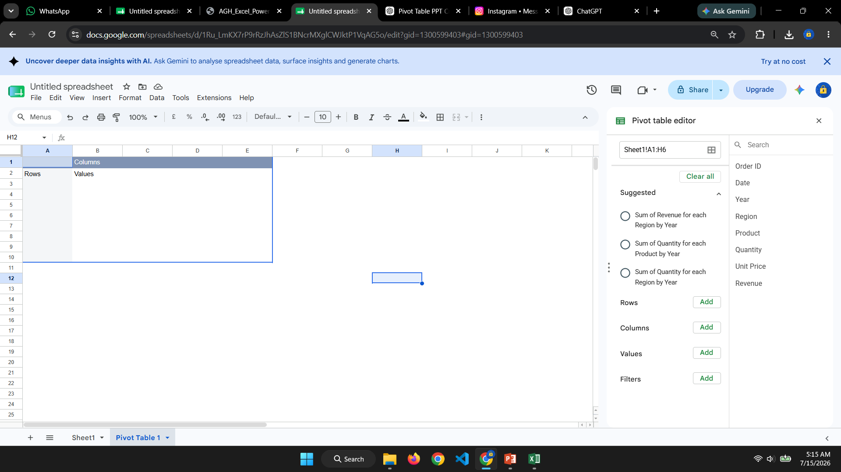
After creating pivot table :

Slide 28
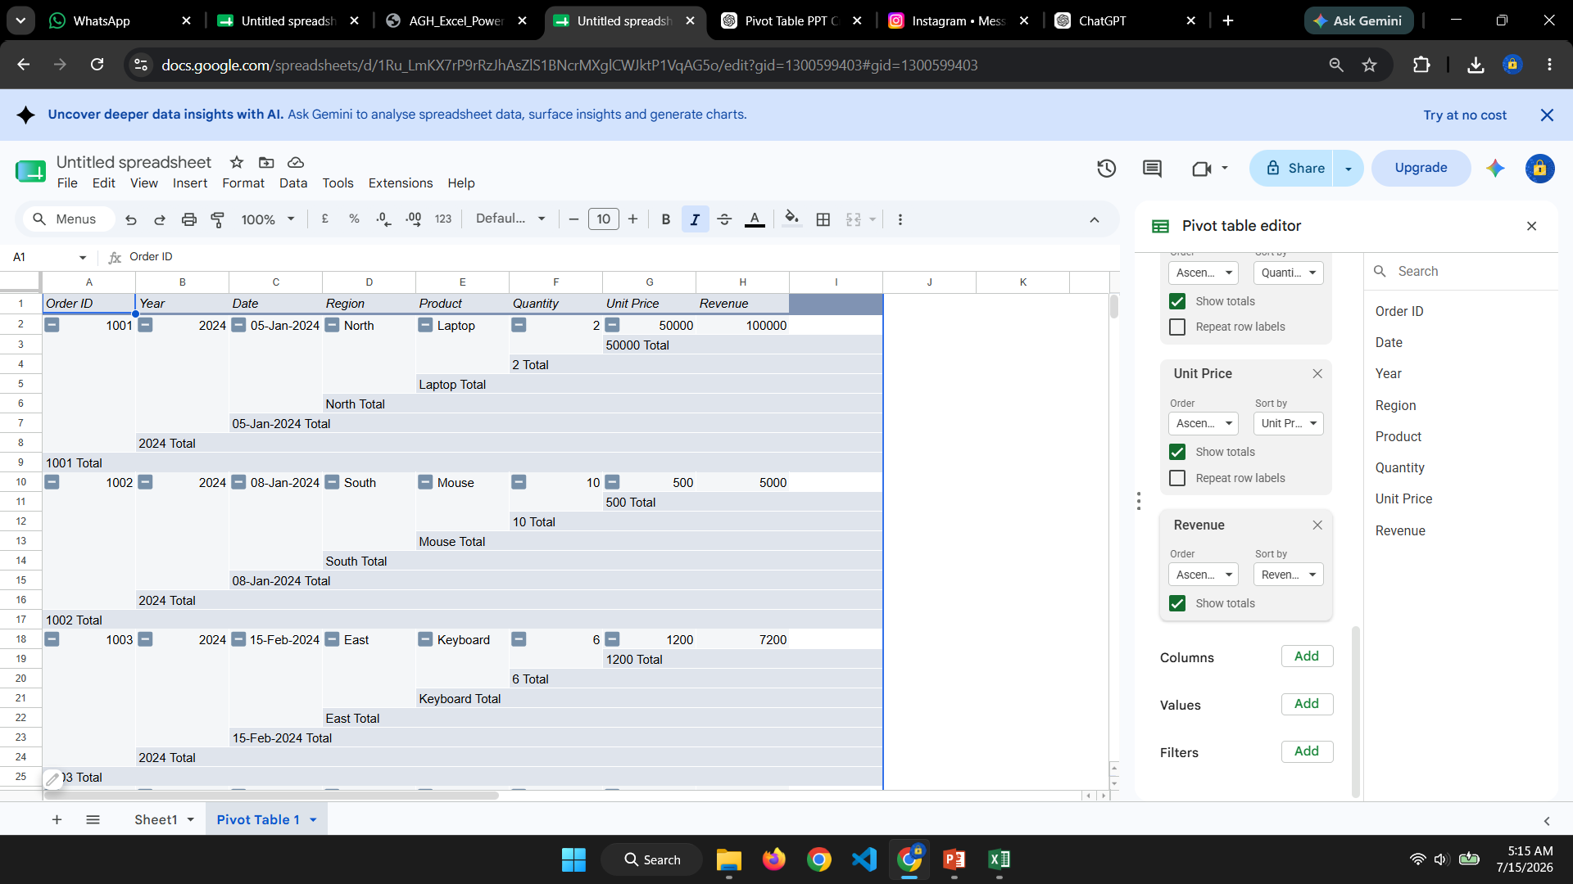
After add every row :

Slide 29
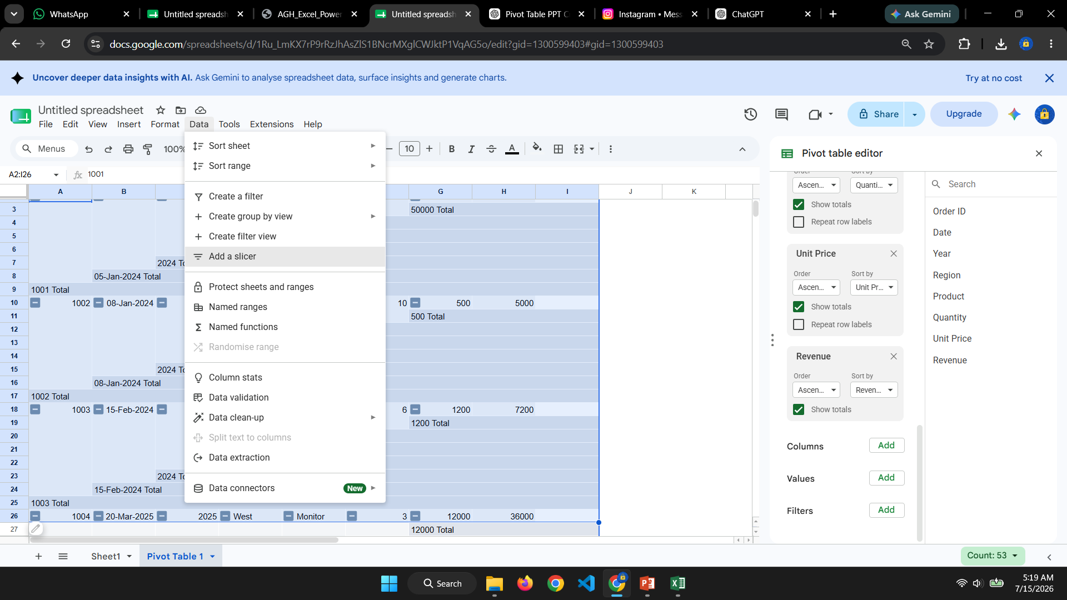

Slide 30
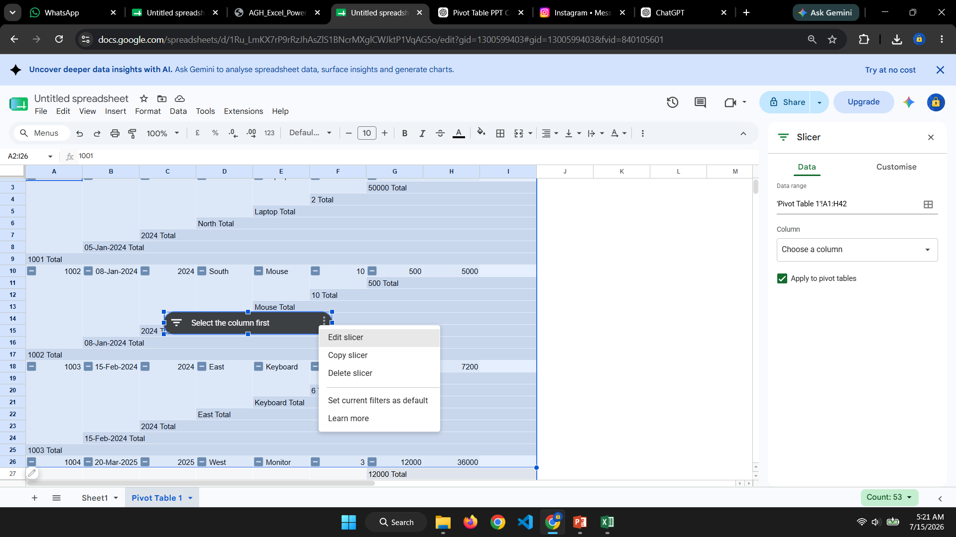
Selecting column filters the Pivot Table and Pivot Chart to display only filtered sales.

Slide 31
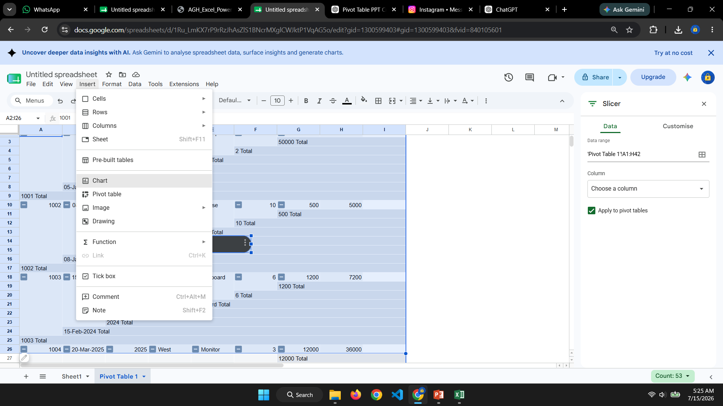
Where chart appears :

Slide 32
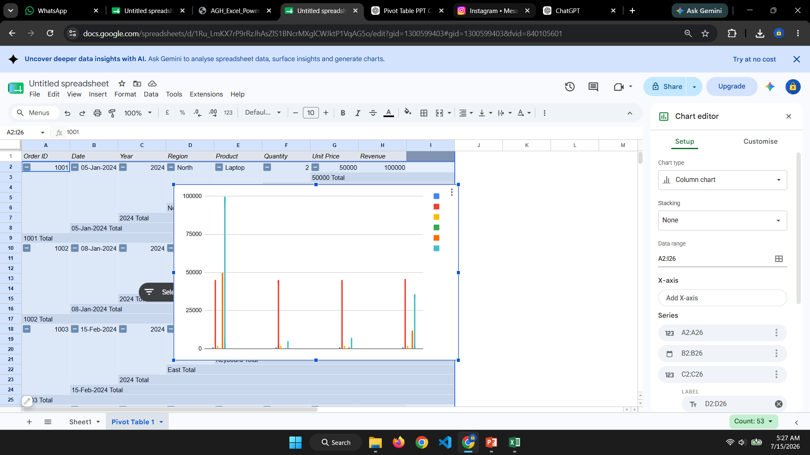
After creating chart :

Slide 33
Create Pivot Bar Chart
Steps
Select any cell in the Pivot Table.
Go to PivotTable Analyze.
Click PivotChart.
Choose Clustered Bar Chart.
Click OK.
Navigation:
PivotTable Analyze
↓
PivotChart
↓
Bar Chart
↓
OK

Slide 34
Ques : Combine 12 Monthly CSV Files Load entire folder of CSVs with Get Data > From Folder; autorefresh when new file added
Explanation: You will get a folder like this:
Monthly_CSV_Files
│
├── Sales_Jan.csv
├── Sales_Feb.csv
├── Sales_Mar.csv
├── Sales_Apr.csv
├── Sales_May.csv
├── Sales_Jun.csv
├── Sales_Jul.csv
├── Sales_Aug.csv
├── Sales_Sep.csv
├── Sales_Oct.csv
├── Sales_Nov.csv
└── Sales_Dec.csv

Slide 35
Next : Open Microsoft Excel
Open a blank workbook.
Go to Data Tab
Click
Data
You should see
Get Data (or) – new Query
Open our 12 months folder inside that

Slide 36
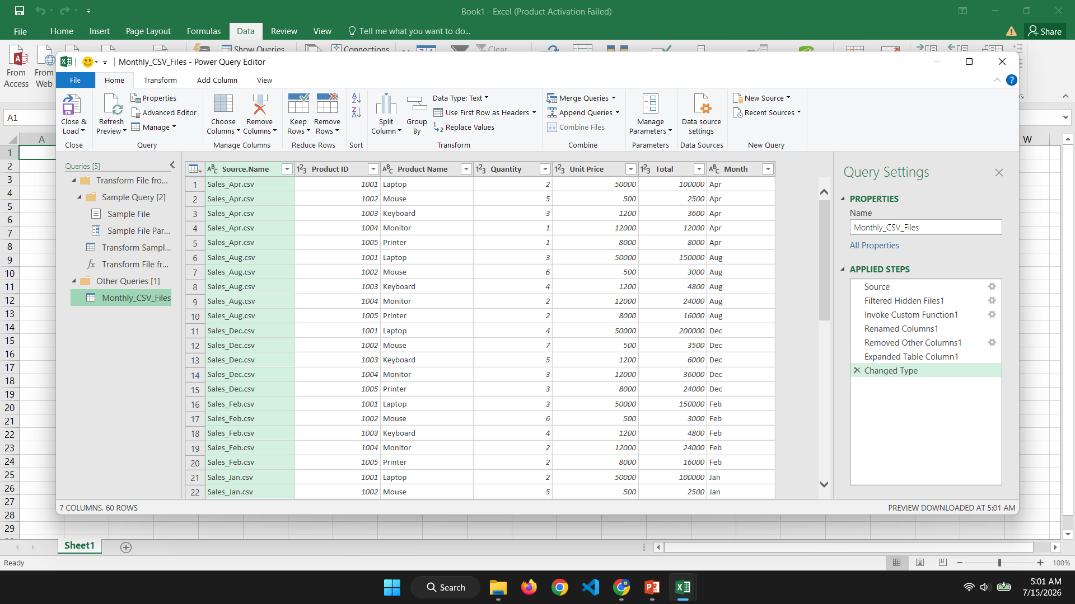
Now Power Query opens separately:

Slide 37
Home
↓
Close & Load
Excel creates one worksheet containing data from all months.
Result
Instead of 12 files...
Product ID | Product Name | Quantity | Month
1001 | Laptop | 2 | Jan
1002 | Mouse | 5 | Jan
1001 | Laptop | 3 | Feb
1002 | Mouse | 6 | Feb
...
Everything is combined automatically.

Slide 38
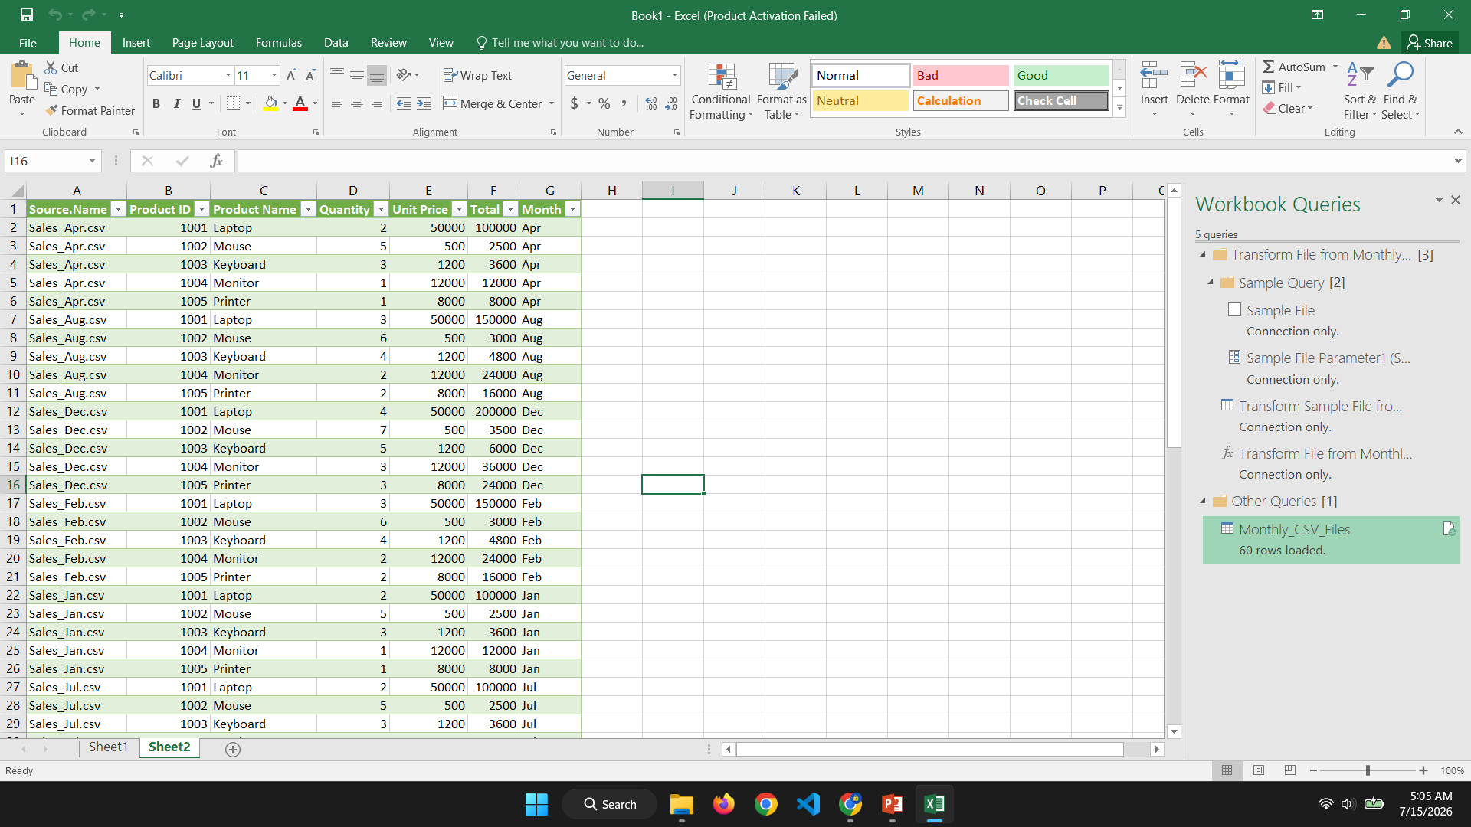

Slide 39
Classroom Activity
Import the 12 CSV files.
Combine them using Get Data → From Folder.
Load the combined data into Excel.
Add a new file (Sales_Jan_2027.csv) to the folder.
Click Refresh All.
Observe that the new records appear automatically.

